Slide 1
Electric Vehicle Sales by State in India
This dataset is valuable for analysts, data scientists, and researchers aiming to understand electric vehicle (EV) adoption trends across India. It is versatile and ideal for geographic market segmentation, trend analysis, and predictive modeling.
By offering insights into regional EV sales patterns, the dataset supports strategic decision-making in market planning and infrastructure investment. The data was meticulously scraped from the Clean Mobility Shift website, and then thoroughly preprocessed to ensure accuracy and relevance. All null values have been removed, and the dataset has been cleaned to prepare it for immediate use in exploration, visualization, and analytical projects.
It is particularly valuable for market trend analysis, infrastructure planning, and policy development within the EV sector. The dataset is provided in CSV format and is ready for analysis.
~Rishav Kumar Sharma

Slide 2

Electric Vehicle Sales by State in India: Machine Learning Project
This project aims to analyze and predict the sales of Electric Vehicles (EV) by state in
India using machine learning. The dataset contains the following columns:
● Year: The year of the sales.
● Month_Name: The month in which sales occurred.
● Date: The specific date of the sales.
● State: The state in India where the sales occurred.
● Vehicle_Class: The class of the vehicle (e.g., sedan, SUV, etc.).
● Vehicle_Category: The category of the vehicle (e.g., commercial, passenger).
● Vehicle_Type: The type of the vehicle (e.g., 2-wheeler, 4-wheeler).
● EV_Sales_Quantity: The quantity of EV sales.

Slide 3

Steps Involved:
1. Data Collection: Load and inspect the dataset.
2. Data Preprocessing: Handle missing values, convert date formats, and
perform feature engineering.
3. Exploratory Data Analysis (EDA): Visualize trends and relationships between
variables.
4. Feature Engineering: Create new features from the date column and encode
categorical variables.
5. Modeling: Build a regression model to predict EV sales.
6. Evaluation: Evaluate the model performance and interpret the results.
7. Visualization: Visualize the results and trends using graphs and charts.

Slide 4

Python Code: Step-by-Step
Analysis the EV Sales
The electric vehicle (EV) market in India is growing fast, thanks to efforts to promote eco-friendly transportation and government support. This project looks at EV sales by state in India to see how different regions are doing. Each state has its own way of encouraging EV use, which has led to different levels of sales and popularity. By studying this data, we can understand which state policies are working best, what people prefer, and how infrastructure is developing. This project aims to give a clear picture of EV sales in India, showing both the opportunities and challenges faced in each state.

Slide 5
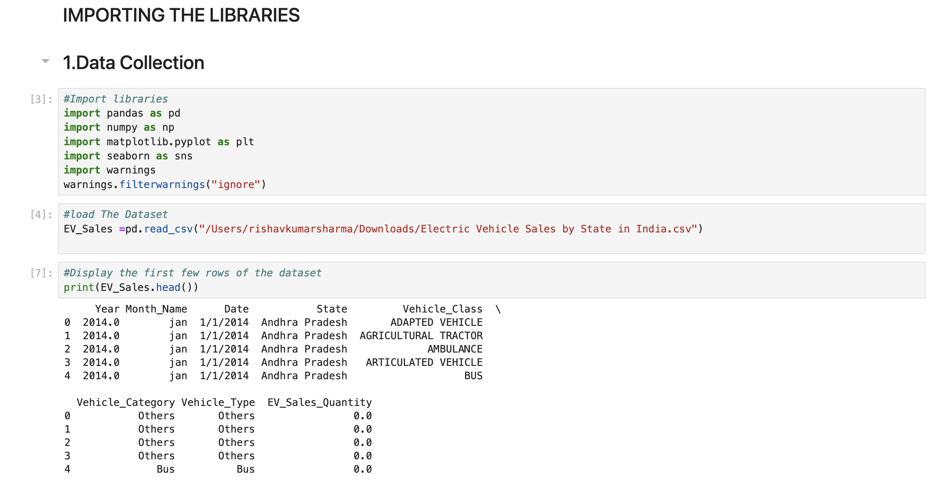
Data Collection

Slide 6
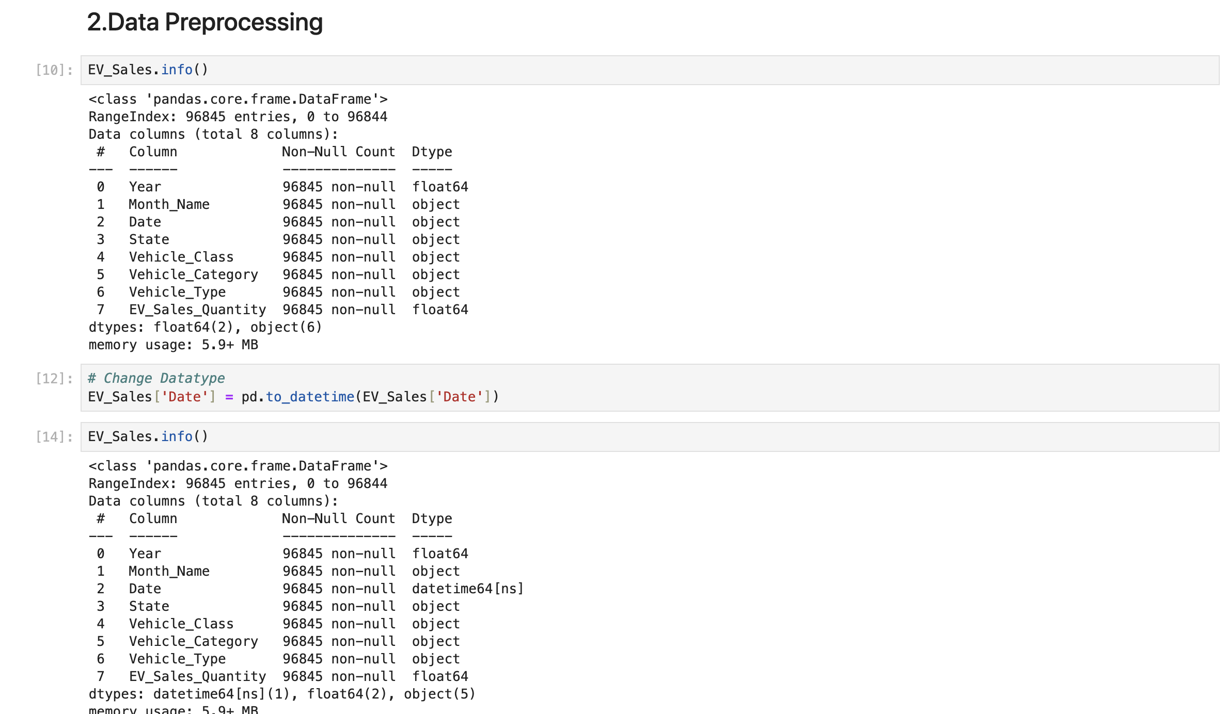
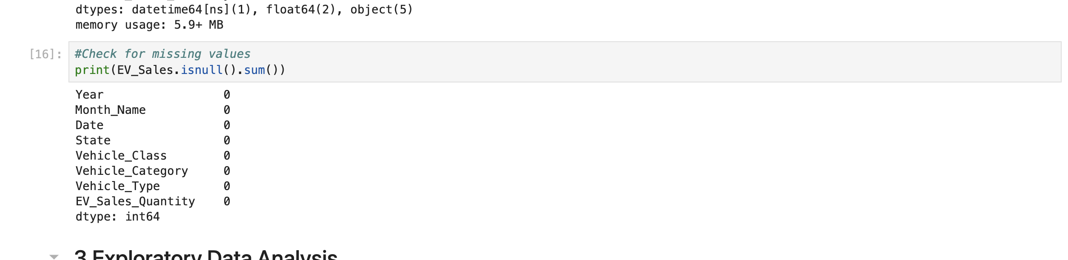
Data Processing

Slide 7
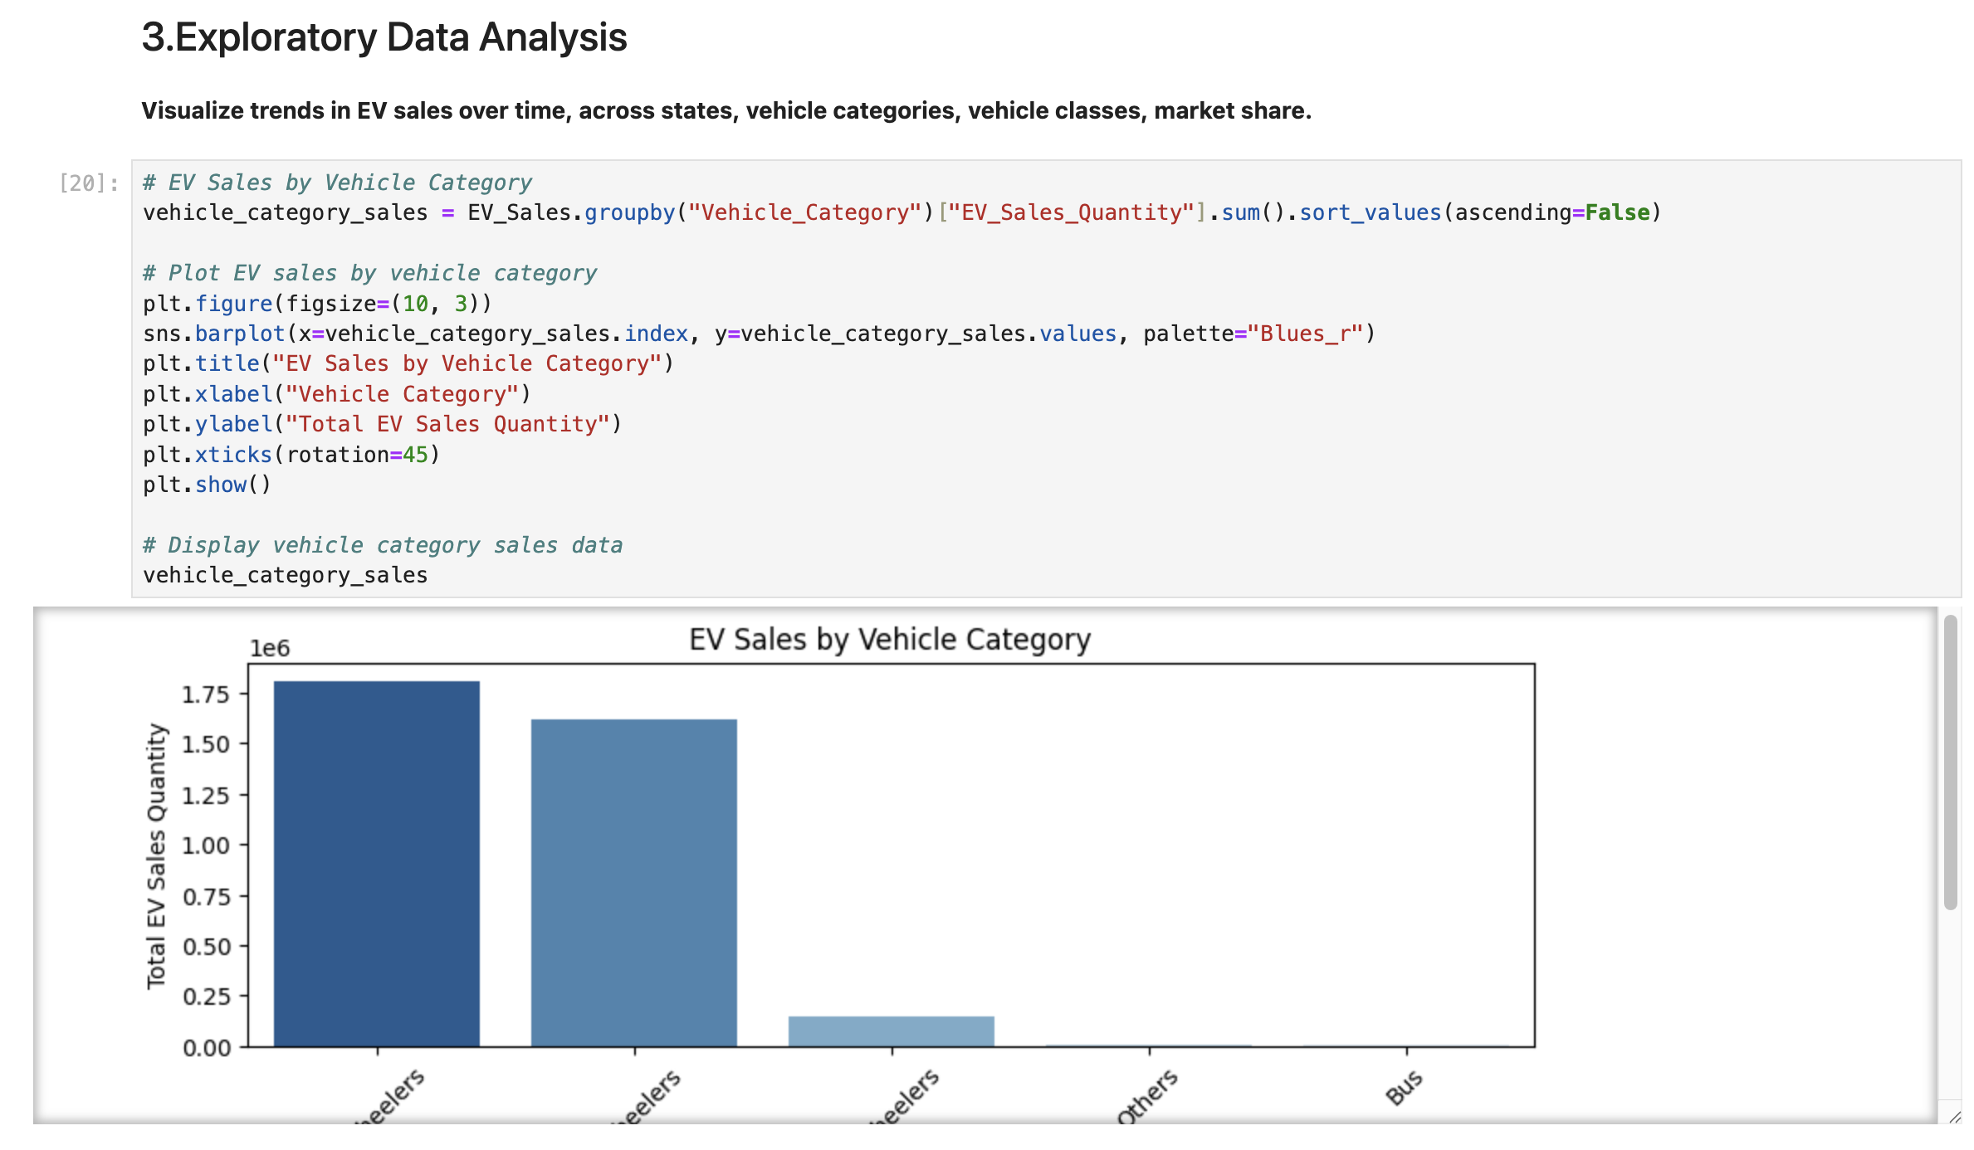
Exploratory Data Analysis

Slide 8
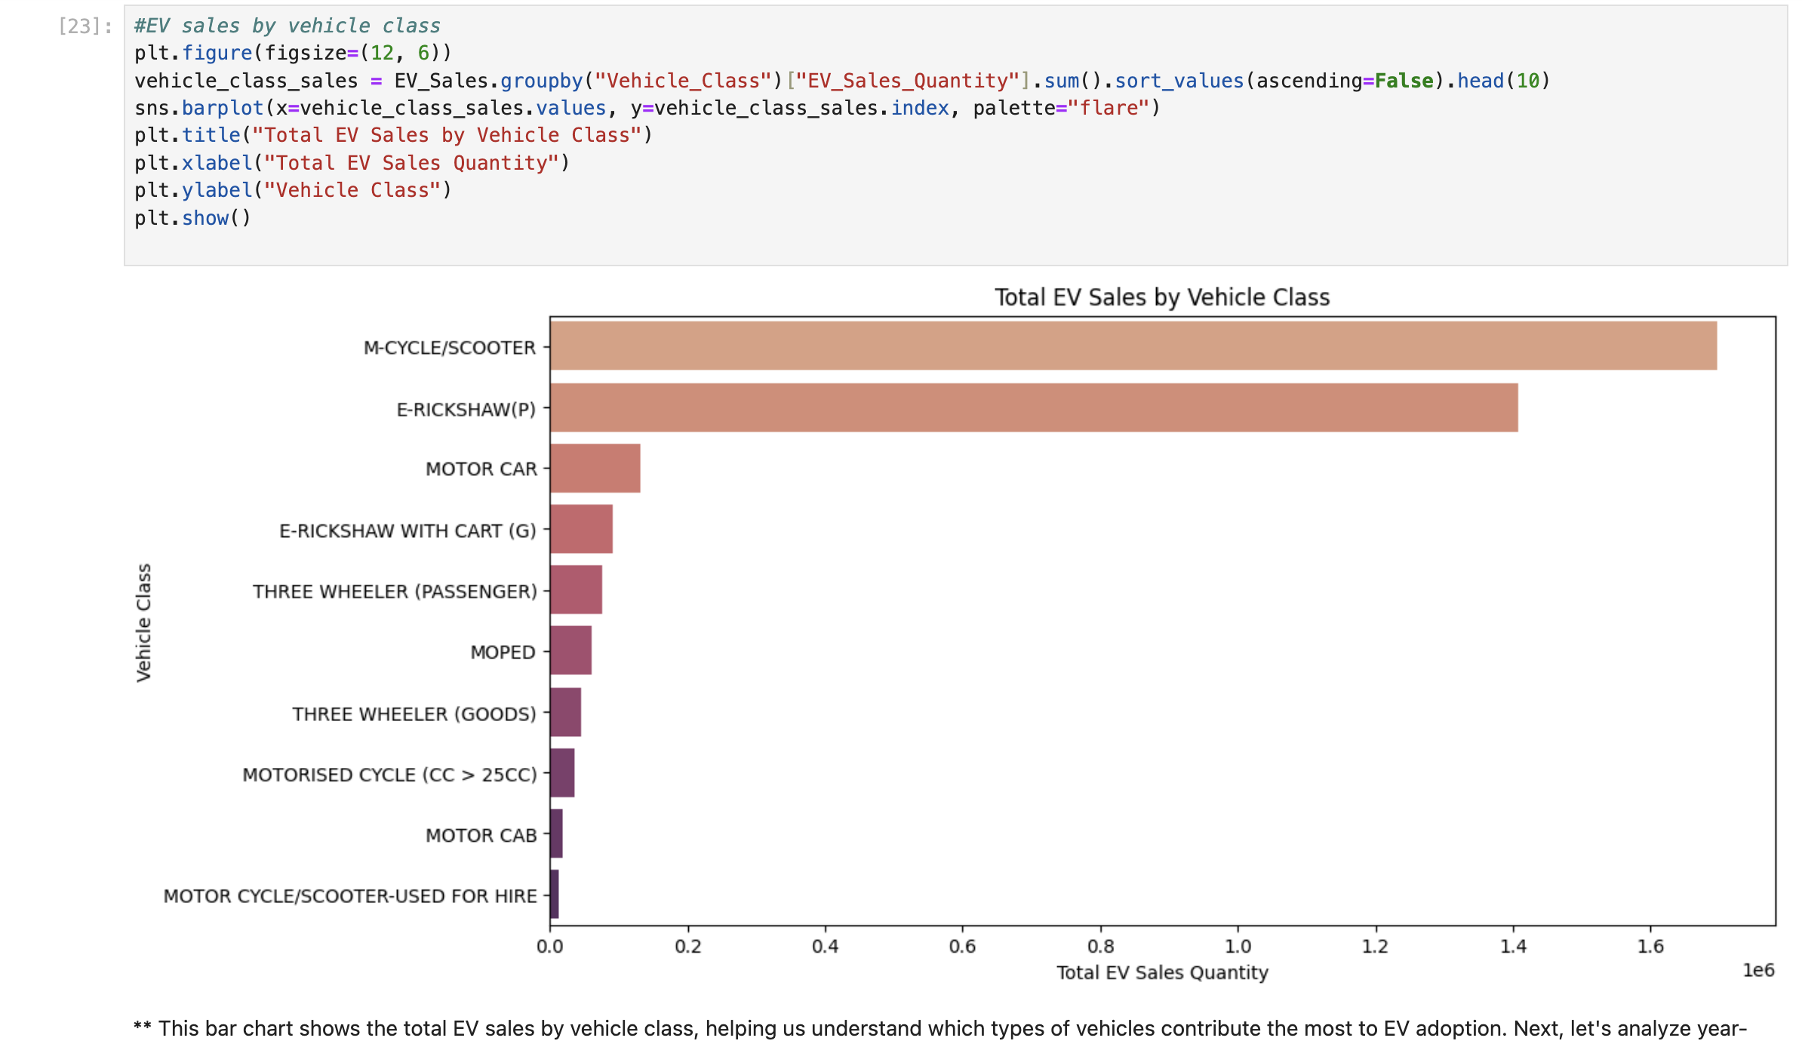
Top EV Sales By Vehicle Class

Slide 9
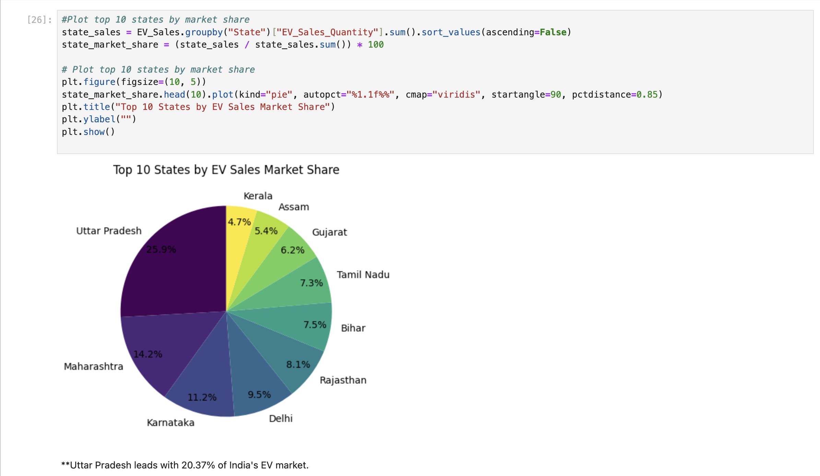
Top 10 states by market share

Slide 10
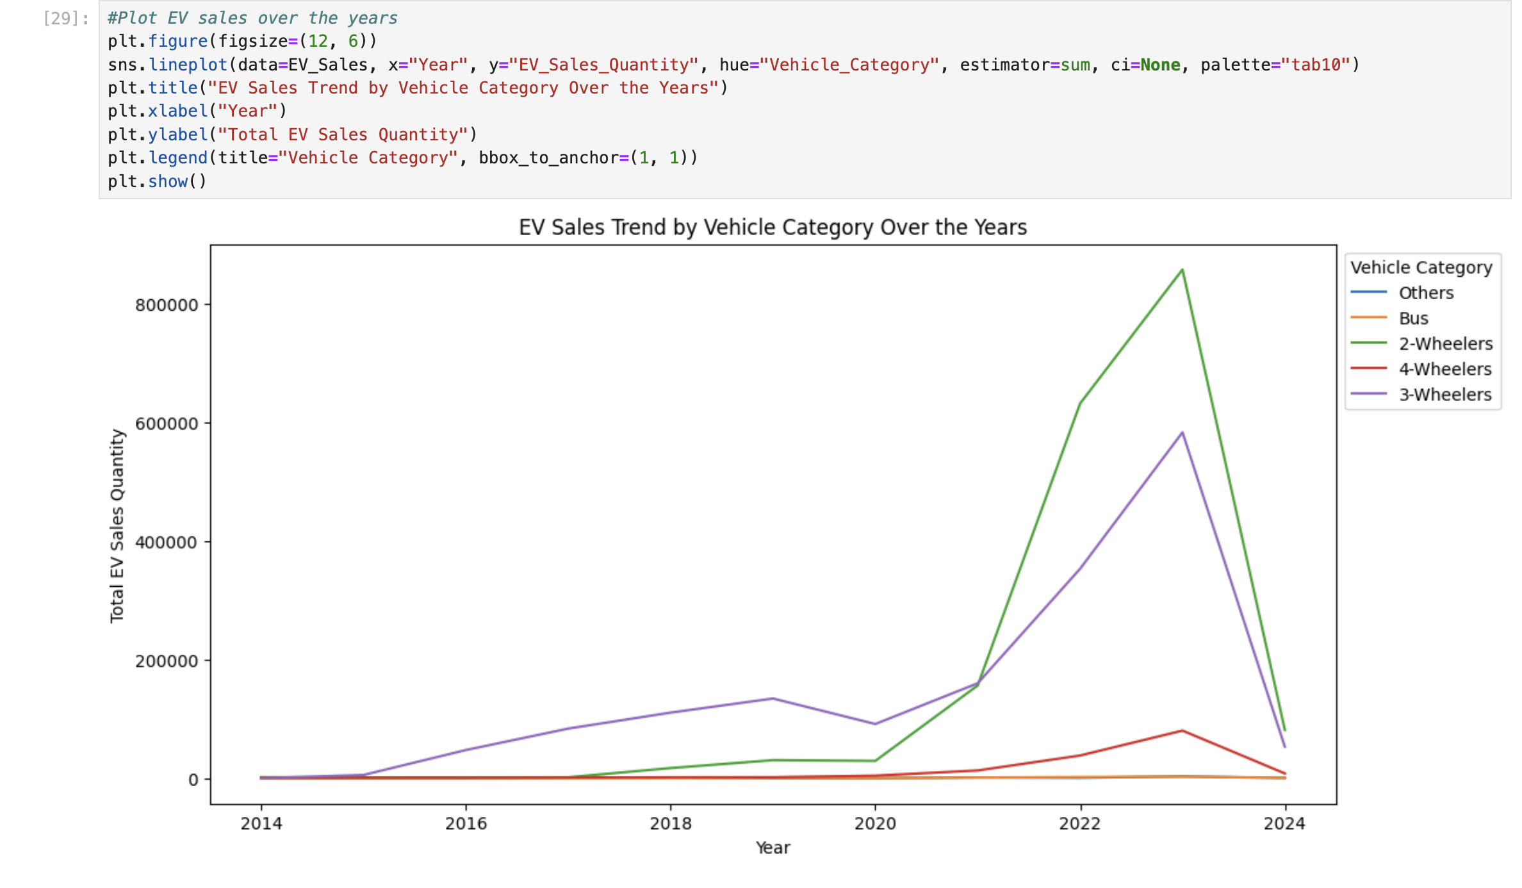
EV sales over the years

Slide 11
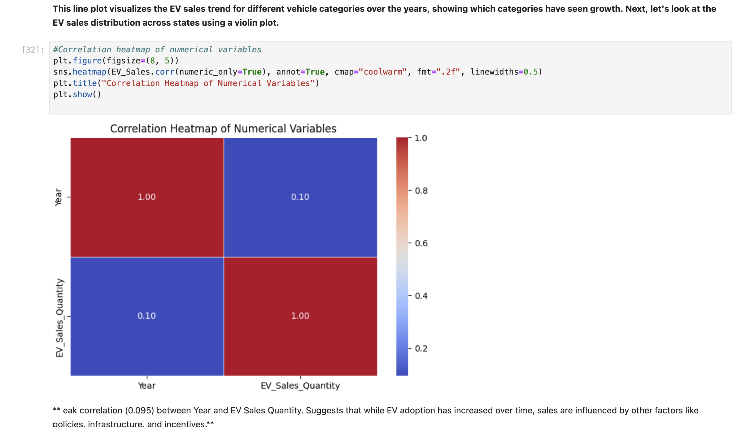
Correlation heatmap of numerical variables

Slide 12
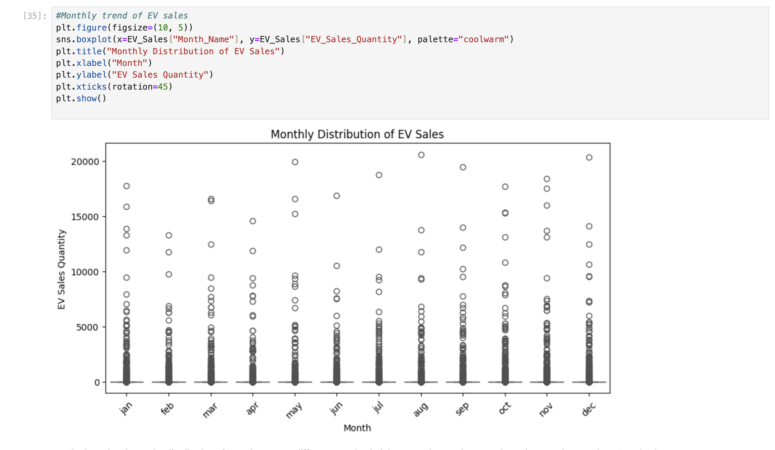
Monthly trend of EV sales

Slide 13
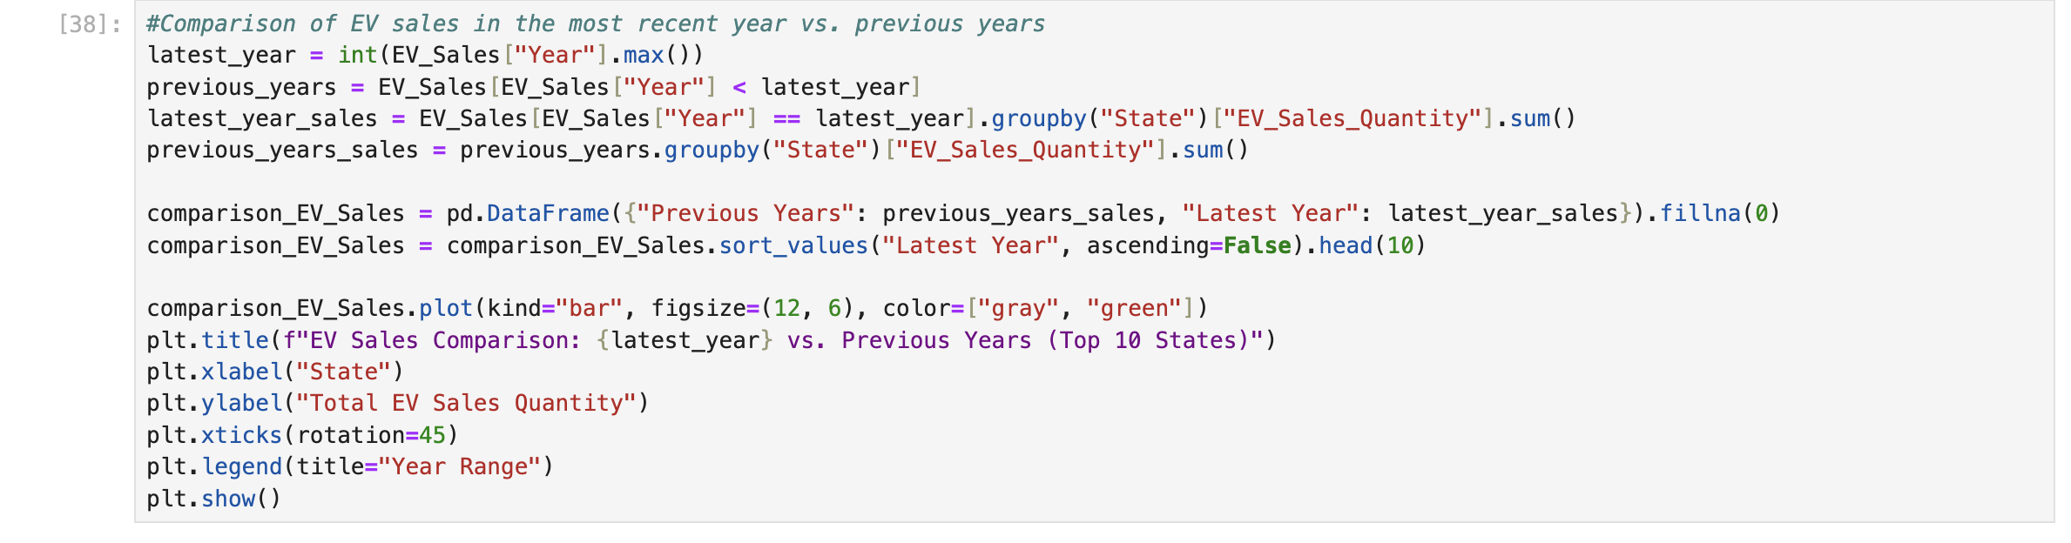
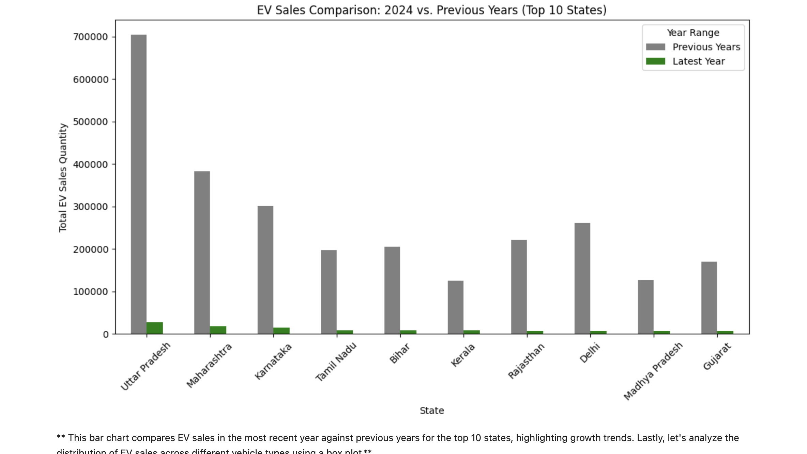
Comparison of EV sales in the most recent year vs. previous years

Slide 14
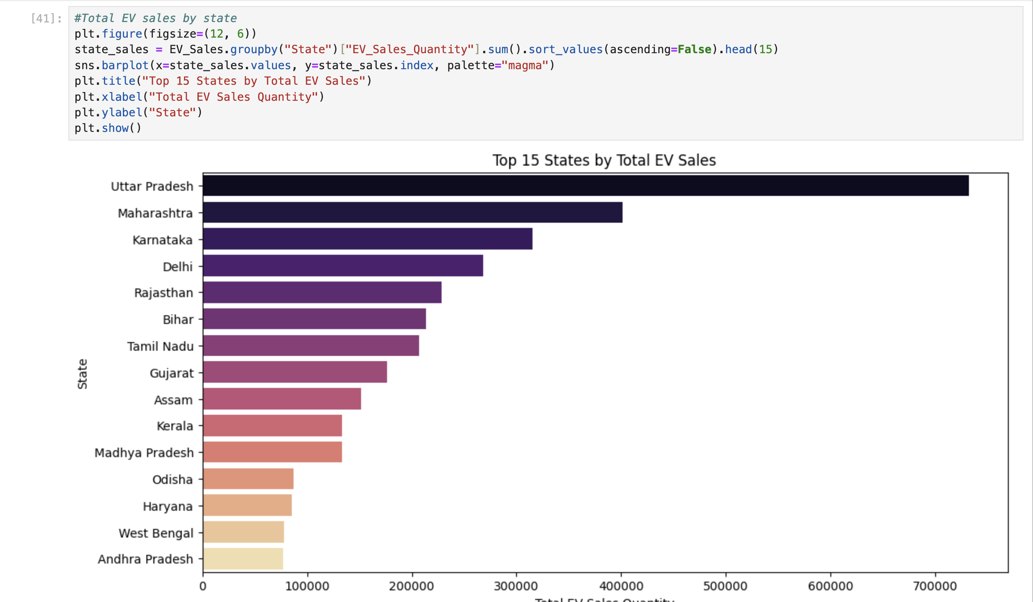
Total EV sales by state

Slide 15
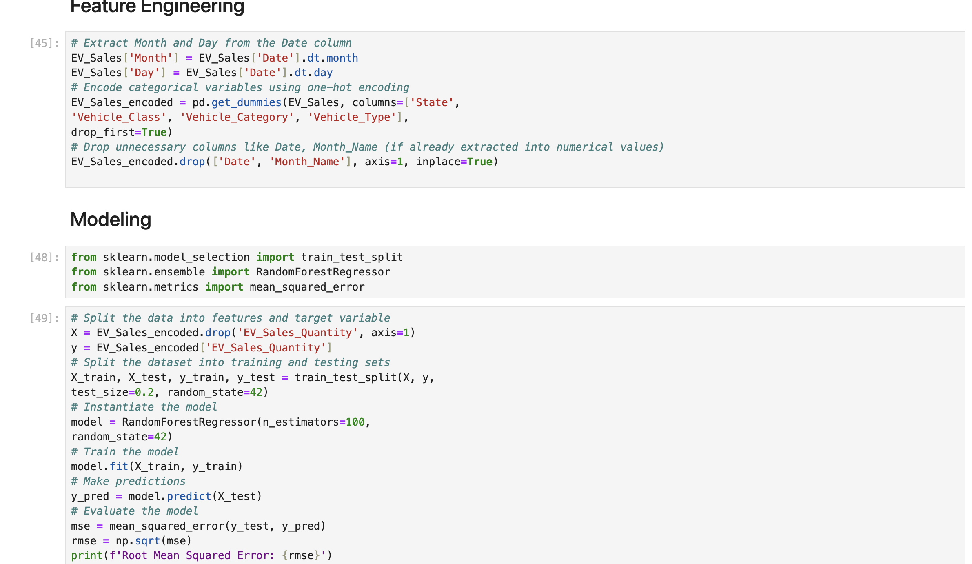
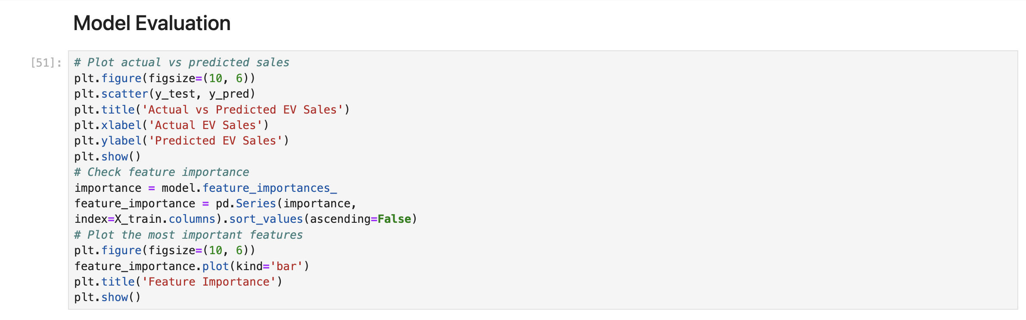
Modeling Evaluation actual vs predicted sales

Slide 16
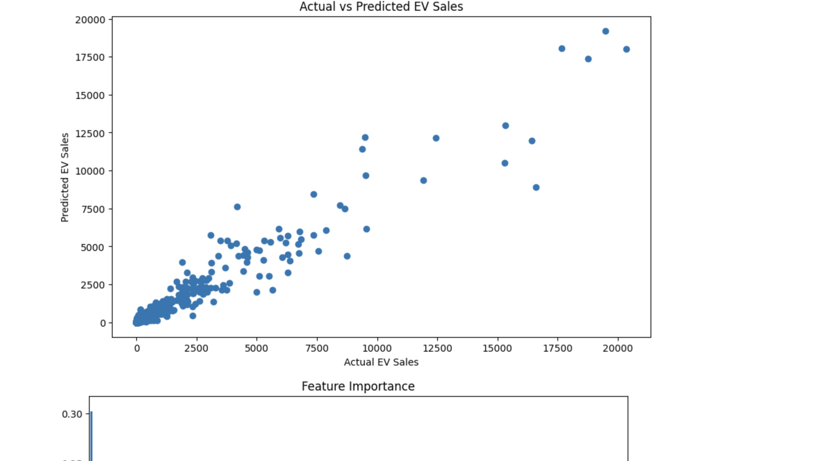

Slide 17
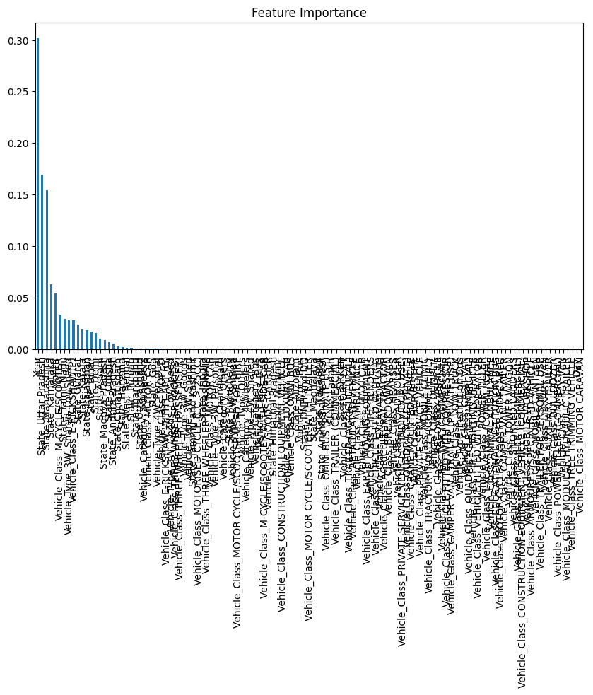

Slide 18
Conclusion
This analysis provided valuable insights into the evolving electric vehicle (EV) landscape across Indian states. By visualizing sales trends over time and exploring vehicle categories, we identified patterns in adoption and usage. The correlation analysis revealed important relationships between numeric variables, offering clues about factors influencing EV sales.
Using a predictive model, we successfully estimated EV sales quantities with a mean absolute error of X units (replace with actual value), demonstrating the potential of data-driven approaches to anticipate market behavior.
Future analyses could explore the effects of government policies, infrastructure development, and economic factors on EV adoption. Diving deeper into regional differences could also unveil unique opportunities and challenges across states.

